Slide 1
Spring Boot
Pet Park Locations: Create Spring Boot/Maven Project

Slide 2
In this video...
Introduction to Maven
How to create a Spring Boot project
Not just slides – we'll code along with what's being taught

Slide 3
Introduction to Maven
Maven is a project build tool
We are using it for dependency (code library) management
How do I get Maven?

Slide 4
Creating a Spring Boot project
Navigate to https://start. spring. io
Build the POM file, using the latest version of Spring Boot 3.x
Paste it into the Maven project
Create the main application class file

Slide 5
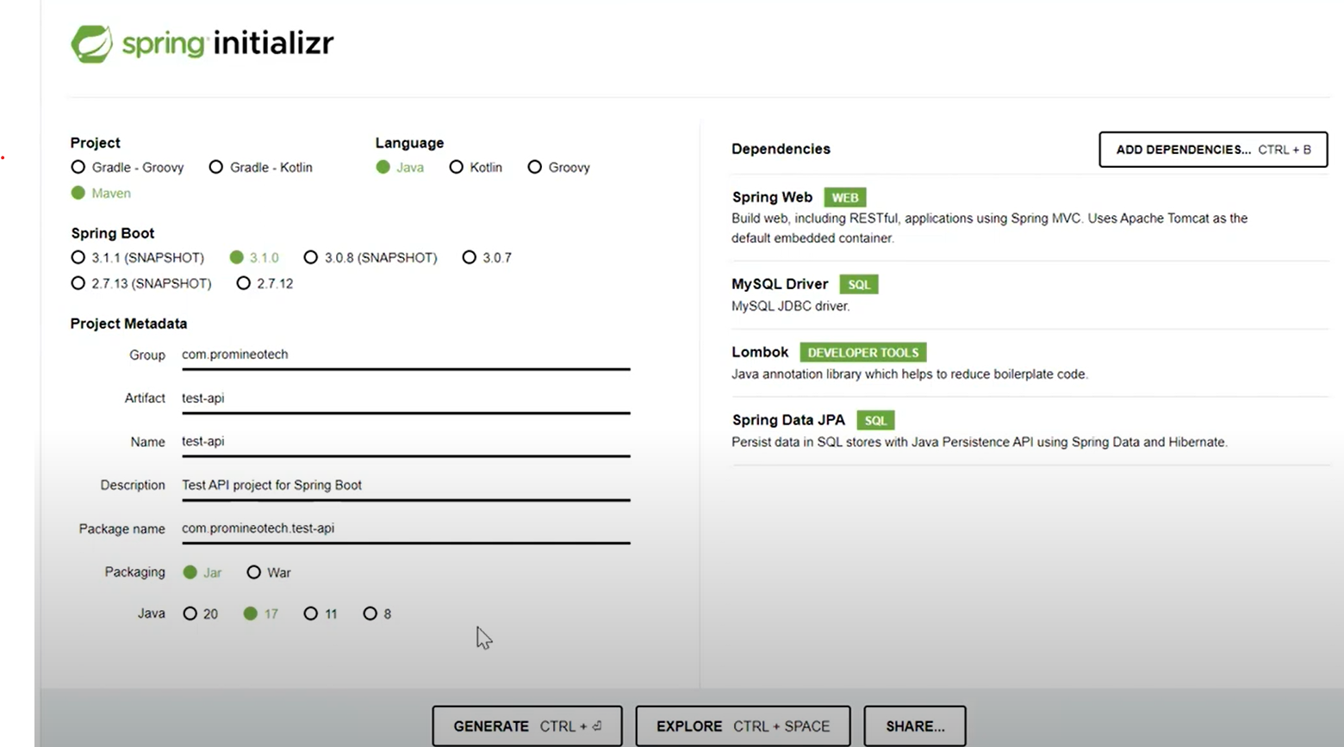

Slide 6
Main application file
@SpringBootApplication
public class PetParkApplication {
public static void main(String[] args) {
SpringApplication.run(
PetParkApplication.class, args);
}
}

Slide 7
@SpringBootApplication
Enables Component Scan
Enables Auto-configuration

Slide 8
Component scan
Boot looks at every class in the main package and all subpackages
Determines if Spring should manage the class
Called a "managed Bean" or Bean
Spring creates a single instance
Stashes it in an object repository
We can request an instance using @Autowired

Slide 9
Component scan
We will write a controller class
Spring's component scan will map HTTP requests to methods that we write
We use annotations to tell Spring which HTTP verb to map to the method
These terms will be explained later
Just know that Internet requests can be mapped to Java methods

Slide 10
Auto-configuration
Spring Boot examines the classpath and the application configuration
It sets up functionality (i.e., Web application) based on what it finds
Spring creates a Web application if it finds the Tomcat dependency
Tomcat is loaded by spring-boot-starter-web

Slide 11
Let's do it!

